Slide 1
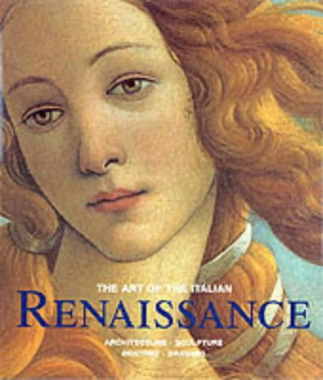
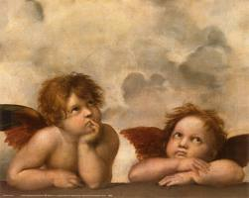
Art Review for the Chapter 13, Sections 1 and 2 Test: The Renaissance
Make sure you study the pictures in this PPT. You must be able to recognize them and to match them correctly with the artist and/or name of the work.

Slide 2
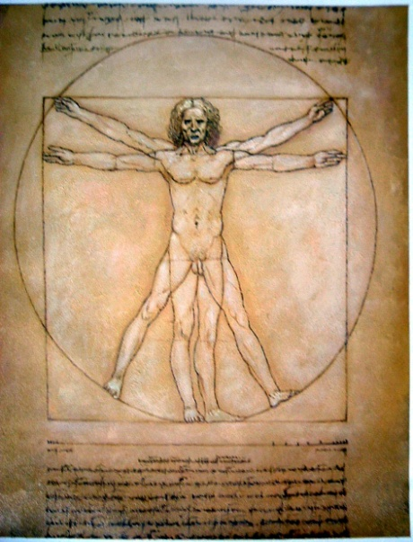
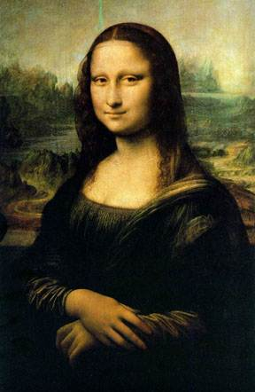
Da Vinci’s “Mona Lisa”
Da Vinci’s “Vitruvian Man”

Slide 3
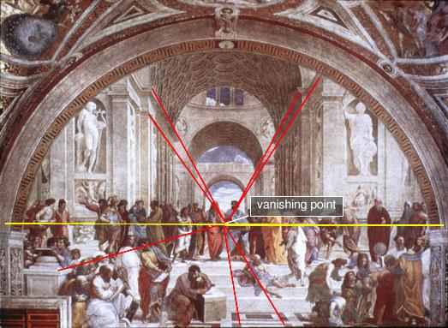
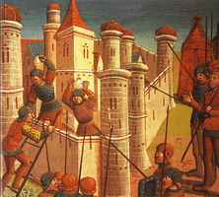
This painting, “The School of Athens”, shows Perspective and the Vanishing Point
This medieval painting shows the people and buildings out of proportion with each other – there is no correct perspective

Slide 4
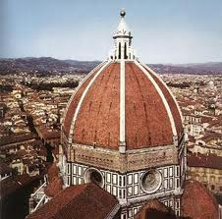
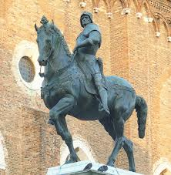
Brunelleschi’s Dome on the cathedral he designed in Florence
Donatello’s life size sculpture of a soldier on a horse

Slide 5
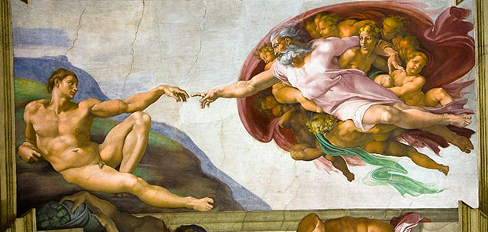
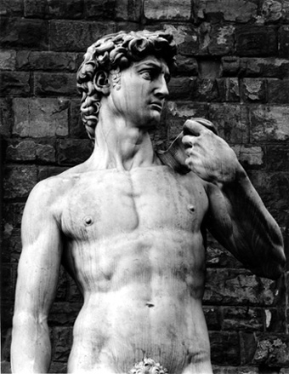
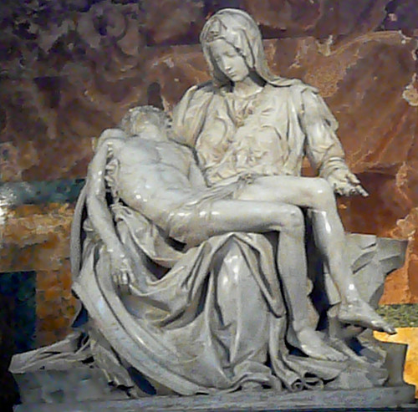
“The Birth of Adam” - painted on the ceiling of the Sistine Chapel in Vatican City
Works by the genius Michelangelo
The Pieta (Jesus w/his mother Mary)
David

Slide 6
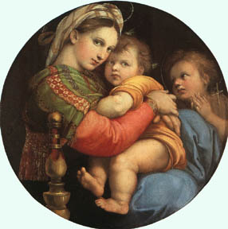
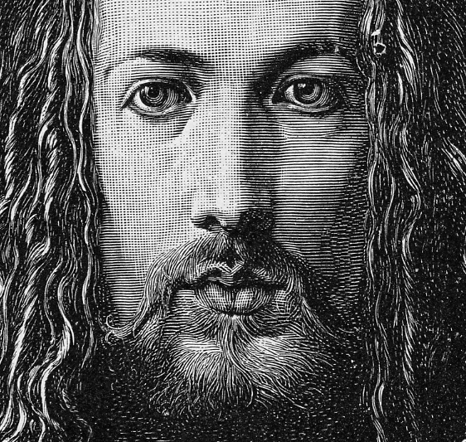
Albrecht Durer’s engraving of Jesus. His engravings portrayed religious upheaval
Raphael’s “Madonna” - painting of Mary the Mother of Jesus holding baby Jesus. He painted many different versions of this same theme.

